Slide 1
Module 3 Utilise appropriate strategies and tools to recognise and validate participants’ learning through intercultural VET mobility experience
Unit 3.2
Review, self-evaluation and assessment of the experiences, of young people participating in intercultural VET mobilities, including their learning and wider outcomes

Slide 2
MODULE 3 UNIT 2
Module title | Utilise appropriate strategies and tools to recognise and validate participants’ learning through intercultural VEY mobility experience
Unit title | Review, self-evaluation and assessment of the experiences, of young people participating in intercultural VET mobilities, including their learning and wider outcomes
Learning objectives | To enable practitioners and organisations to enhance the support provided to participants in intercultural VET experiences To help learners to be reflective and able to identify achievements, personal goals, changes and personal development from being in a different cultural context. To enable practitioners and organisations to enhance the impacts of non-formal learning on participants through a clear assessment process and effective follow-up. To construct and conduct a quality assurance procedure in order to facilitate evaluation and assessment
Training hours | 3 hours (plus online activities for the whole module)

Slide 3
UNIT CONTENT
Tools for recording learners’ achievements
Tools for helping learners modify their behaviour
Twenty first century skills revisited
Assessment processes – from evaluation to accreditation
Assembling a portfolio of evidence of learning
Understanding criterion referenced assessments

Slide 4
TIME FOR ACTIVITY
ACTIVITY NUMBER: 3.2.2
ACTIVITY TITLE: Following up and evaluating learning gained in non-formal and informal contexts
ACTIVITY DURATION: 20 minutes
COMMENTS:

Slide 5
Learner reflection and self-evaluation
Young people taking part in intercultural experiences will encounter new people, places and situations, some of which may provide useful and lasting learning experiences.
It is important that they maximise the possible benefits to be gained, by maximising their understanding of their new experiences.

Slide 6
Preparing for an intercultural mobility
In unit 2.3 we considered a tool to assist young people with documenting experiences that they find surprising, upsetting, very pleasing of significant in some other way whilst on an intercultural mobility.
In unit 3.1 we considered how VET providers could develop tools to assist young people with documenting their attitudes to preparing for participating in a mobility programme.

Slide 7
Preparing for an intercultural mobility
In unit 3.1 we also considered a tool to assist young people with documenting how easy they found it to deal with situations they were likely to encounter during a mobility.
We will now introduce another tool which is designed to help learners who are finding a particular cultural phenomenon personally challenging.
It is important to capture all situations where there is a new learning experience, however challenging, because such situations can provide great potential for personal growth and therefore for accrediting more learning.

Slide 8
The DISCo Steps Stretch Tool
Produced by the University of Warwick in the UK, this tool can be used DURING a mobility.
See https://warwick.ac.uk/fac/soc/al/globalpad/openhouse/interculturalskills/globalpad_stretch.pdf
What is different about the way in which this tool could both support and document learners’ development?
It is designed to change behaviour not just document it
How might the DISCo Steps Tool assist your organisation in mapping the learning and development of young people on an intercultural mobility?

Slide 9
The DISCo Steps Stretch Tool
Because it is a journal-type tool, this means that much of the data it produces is descriptive rather than evaluative.
For this reason it is helpful to use more than one type of assessment tool to determine the extent to which a learner has developed.
In this way, VET assessors make comparisons more easily with attainment levels achieved in informal learning situations.

Slide 10
TIME FOR ACTIVITY
ACTIVITY NUMBER: 3.2.3
ACTIVITY TITLE: Criterion referenced assessment
ACTIVITY DURATION: 30 minutes
COMMENTS:

Slide 11
Criterion referenced learning
You are going to do a BARRIER ACTIVITY
Work in pairs, preferably with colleagues from your own organisation.
Label yourselves. One of you is A and one is B.
You will receive a passage to read. Make sure that your partner DOES NOT SEE IT!!
To help with this, you may prefer to sit back to back, or erect a barrier between you.

Slide 12
Don’t let your partner see your reading passage!
sit back to back
OR
erect a barrier between you

Slide 13
Criterion referenced learning
Read through your passage carefully. The topic is the same as your partners, but the text is a little different.
You should take turns to ask each other questions.
Use the information in your passage to ascertain if your partner’s answers are correct. If you are not sure, ask your own probing questions until you are satisfied.
Make a note of the answer your partner gives.
When the trainer asks you, compare answers.

Slide 14
Criterion referenced learning
Now, both work with your partner to explain the main ideas about criterion referenced assessment and its features in a diagrammatic way. It can be a flow chart, mind map, storyboard or another type of diagram.
VET organisation develops criteria for assessment
Criteria shared with learners
in a variety of workplaces
Assessment takes place
more transparently
more fairly
Learners develop critical thinking skills

Slide 15
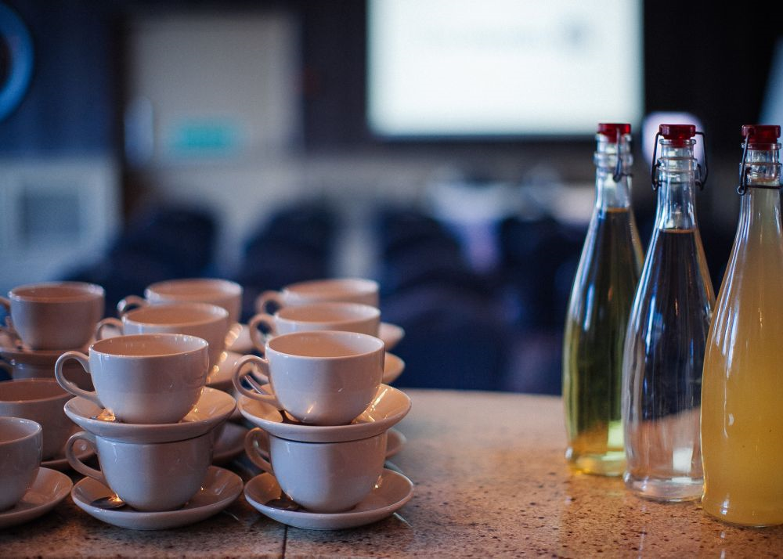
Break

Slide 16
TIME FOR ACTIVITY
ACTIVITY NUMBER: 3.2.4
ACTIVITY TITLE: Twenty first century skills revisited
ACTIVITY DURATION: 30 minutes
COMMENTS:

Slide 17
Twenty-first century skills
Twenty-first century skills are those which relate not only to personal development, but also vocational qualifications.
In unit 2.3, we ranked a number of them in terms of their importance for our learners.
This is also a useful exercise for learners to complete, as the extent to which they have developed each skill, can be measured and contribute to a final portfolio for gaining a qualification.

Slide 18
The Valley Project
We are grateful to our colleagues from the Valley Project who have produced a system for evaluating a volunteer’s competence in a range of skills.
Learners are assessed from three different perspectives:
their knowledge (les connaissances)
their abilities (les capacités)
their attitudes or behaviours (attitudes)

Slide 19
The Valley Project
How could a format like this assist your learners with assessing skills, personal development and learning acquired in an intercultural context?

Slide 20
Le livret de compétences
Le livret de compétences is not based on twenty-first century skills.
It does, however, set out a comprehensive list of competencies which are based on the European Key Competences for Lifelong Learning that we first encountered in unit 2.1.
It is not currently downloadable so ask the trainer if you would like a copy.

Slide 21
TIME FOR ACTIVITY
ACTIVITY NUMBER: 3.2.5
ACTIVITY TITLE: Incorporating knowledge of informal assessment systems into programme planning and design
ACTIVITY DURATION: 30 minutes
COMMENTS:

Slide 22
Taking the next step
Learners will accumulated a variety of skills and competences in their home country and during the intercultural mobility.
VET organisations and practitioners will have devised systems for assessing and recording this learning, gained in informal and non-formal settings.
VET organisations and practitioners must now consider how data collected by the assessments they have devised can be aligned with nationally recognised standards.
In this way, learning can be validated against local and national benchmarks and eventually against European benchmarks.

Slide 23
ASDAN
ASDAN is a third sector organisation based in the UK which also awards qualifications at a national level.
You will be given some examples of ASDAN assessment systems to illustrate how competences, such as those designed by the Valley Project, or the 21 Century Skills we considered in Module 2, can be elaborated into an evaluative system, aligned to national qualifications.

Slide 24
ASDAN
We are using the ASDAN example because:
its courses are well known for providing engaging courses that offer personalised learning and choice, focusing on core skills such as teamwork, communication, problem-solving, research and self-management.
they are also well known for successfully mapping the progression of educationally disadvantaged learners, like the learners targeted by this Intercultural Mobility Project.
ASDAN programmes lead to qualifications at the national level, which has parity with EQF.

Slide 25
Handout1_CoPE.pdf
Take a few moments to read through this learner’s portfolio. Work in pairs to identify:
the task that has been set and the steps involved to complete it
three 21 century skills that the learners have applied to fulfil the task, e.g team work, time management etc.
elements of the assessment that involve journalistic processes
elements of the assessment that involve evaluative processes
elements of the assessment that involve criterion-based evidence

Slide 26
Handout1_CoPE.pdf
Discuss:
How does this assessment process relate to the way in which informal learning is assessed by your organisation?
How would your organisation have to adapt current arrangements for assessing learners in order to standardise learner outcomes?

Slide 27
Handout2_provsolv.pdf
This is taken from the ASDAN problem solving module. Compare the levels 1 and level 3 guidance and identify:
the difference in the knowledge, skills and techniques required by the two levels
the changes in learner outcomes
the differences in assessment criteria to be demonstrated as evidence that the learning has taken place

Slide 28
Handout2_provsolv.pdf
Each learning outcome is a ‘rich task’ involving a mixture of activities, knowledge and skills. It uses criterion referenced assessment to measure personal developmental skills within practical contexts. In your groups discuss:
How might VET organisations and their mobility partners change or improve the development of graduated, structured tasks and assessments that add value to learners’ experiences and work towards meeting national standards?
For more information see: https://www.asdan.org.uk/courses/courses-for-your-setting/post-16

Slide 29
TIME FOR ACTIVITY
ACTIVITY NUMBER: 3.2.6
ACTIVITY TITLE: Further reading, self-assessment and reflection
ACTIVITY DURATION: 10 minutes
COMMENTS:

Slide 30
Further Reading
Autoévaluation_valley.pdf. Available shortly from http://www.intercultural-mobility.eu/en/home/
“Livret de compétences”, Association ADICE

Slide 31
Self assessment and reflection
Use the self-evaluation and reflection form to summarise your thoughts on the learning from this session.

Slide 32
Congratulations!
You have completed this unit

