Slide 1
Module 2 Develop and manage VET intercultural mobility programmes
Unit 2.3
Understanding and supporting intercultural VET programme participants

Slide 2
MODULE 2 UNIT 3
Module title | Develop and manage VET intercultural mobility programmes
Unit title | Understanding and supporting intercultural VET programme participants
Learning objectives | To develop understanding of the diverse backgrounds, needs and aspirations of target groups of young people involved in intercultural VET programmes. To explore ways that providers can adapt programmes, activities and support to meet young people’s different needs and capabilities.
Training hours | 3 hours (plus online activities for the whole module)

Slide 3
UNIT CONTENT
Understanding the needs and aspirations of participants in intercultural VET programmes
21st century skills
Managing Culture Shock
Preparing for an intercultural mobility
Dealing with problems when they arise

Slide 4
TIME FOR ACTIVITY
ACTIVITY NUMBER: 2.3.1
ACTIVITY TITLE: Understanding the needs and aspirations of participants in intercultural VET programmes
ACTIVITY DURATION: 60 minutes
COMMENTS:

Slide 5
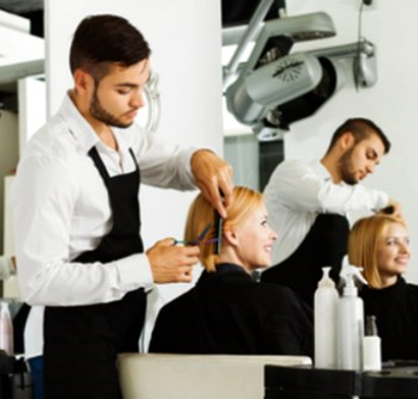
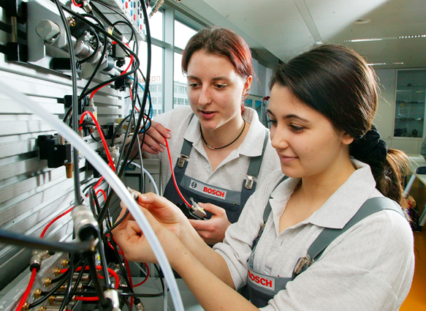
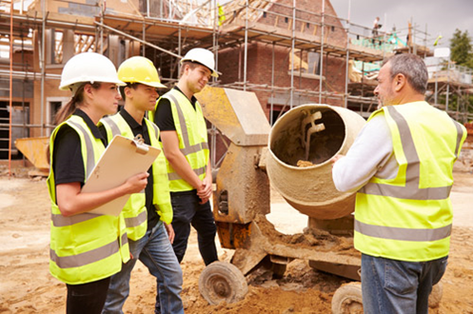
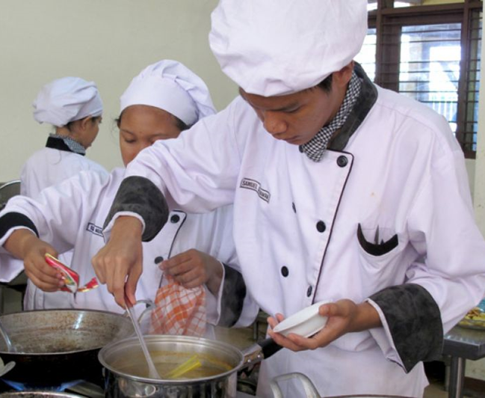
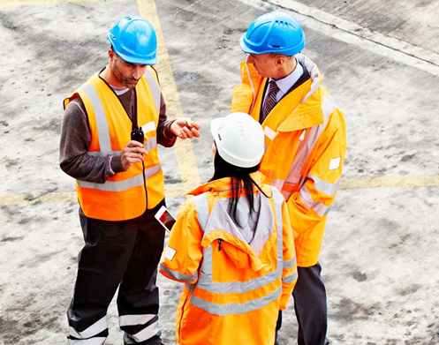
Which of these images do you identify with most? Why?

Slide 6
What skills do young people need?
For many years, people have tried to document the skills that will be of most benefit to us in the twenty-first century.
You will be given a set of cards detailing a number of skills. Read through them and identify the top 10 skills that are important for your learners’ development.

Slide 7
What skills do young people need?
Rank your top 10 skills in the shape of a pyramid, with the most important one at the top, the next two underneath, and so on.
1
2 3
4 5 6
7 8 9 10
Take a photograph of your work. Post it on the online forum with an explanation of why you made these choices.

Slide 8
Case studies
You will now be given two case studies.
Read through them and answer the questions at the end of each one.
Which of the twenty-first century skills do you think were applied in each case study to make the intercultural element successful?
Use the grid (2_3_1_Evaluating case studies.docx) to set out your evaluation of the twenty-first century skills.

Slide 9
TIME FOR ACTIVITY
ACTIVITY NUMBER: 2.3.2
ACTIVITY TITLE: Preparing for an intercultural mobility
ACTIVITY DURATION: 30 minutes
COMMENTS:

Slide 10
Preparing for an intercultural mobility
Once a project has been agreed, the preparations must begin. The project is more likely to be successful if it has been well planned.
Every intercultural mobility is different, but a list of things that should be planned for could include the following items:

Slide 11
List of items to plan for when undertaking an intercultural mobility
location of the placement
dates of the placement
duration of the placement
accommodation
partners and organisations involved
fellow-participants
learning objectives and outcomes
learning content
systems for assessment and evaluation
systems for reporting back and sharing the learning

Slide 12
Additional planning
In the case of intercultural exchanges, where there may be differences in language, culture, food, daily routines etc., there may be a greater potential for misunderstandings or miscommunications to occur. To avoid this, additional planning is required.

Slide 13
List of items to plan for when undertaking an intercultural mobility
Additional planning should address all aspects of participants’ needs, including:
Personal readiness
how well have participants prepared themselves?
Issues that may arise during the placement
what skills and tools do participants have for dealing with the unexpected?
Things to do when participants return home
how to evaluate the success of the intercultural experience?

Slide 14
List of items to plan for when undertaking an intercultural mobility
You will be given a list of twenty criteria that can be used for additional planning in preparation for an international mobility.
Work with a partner to identify four criteria that are important to you and determine:
what types of help and support you can get with each one and
who might provide the support.
Write the outcome of your discussions in the grid provided.

Slide 16
TIME FOR ACTIVITY
ACTIVITY NUMBER: 2.3.3
ACTIVITY TITLE: When problems arise
ACTIVITY DURATION: 60 minutes
COMMENTS:

Slide 17
What is “culture shock”?
Have you, or anyone you know, ever experienced “culture shock”?

Slide 18
What is “culture shock”?
“Culture shock” is a term that can describe the feelings that arise as a result of moving from a familiar culture to one which is unfamiliar. Anyone can experience it, but it usually describes people who have travelled abroad to work, live or study.
Sometimes, being in a new environment, meeting lots of new people and learning the ways of a different country can seem overwhelming. If these feelings occur at a moment when an individual also feels separated from the important people in their life – family, friends, colleagues, teachers – people they would normally talk to at times of uncertainty, who give them support and guidance, their feelings of strangeness or unfamiliarity may become very prominent.

Slide 19
What is “culture shock”?
Should we be worried about experiencing “culture shock”?
No!
It is not unusual to feel some level of disorientation if we find ourselves in a new situation. If, in addition, a person is tired, perhaps experiencing jet lag, small things may become upsetting out of all proportion to their real significance.

Slide 20
What is “culture shock”?
However!
Responses to encountering a different culture can be extremely disconcerting for both parties in an intercultural encounter, if one or more of the individuals involved is culturally introverted. Research undertaken by Margalit Cohen-Emerique points out that:
“Selective perceptions, fear of the unknown, prejudices, ethnocentricity, the tendency to actively systematise differences into a schema of devaluation, discrimination and even racism, constructs filters and cognitive and emotional barriers which obstruct an individual from being open to the culture of the ‘other’, and to the recognition and tolerance of differences.”
See: http://www.iteco.be/ressources/concepts-grilles-d-analyse-exercices-et-jeux-dont-le-jeu-des-chaises/Le-choc-culturel,44

Slide 21
What is “culture shock”?
To avoid such experiences for the young people who are undertaking intercultural mobilities it is therefore vital that organisations
are confident about the openness of the organisations they are partnering with and are assured that there are processes in place to deal with any direct ‘othering’, intolerance, ethincally-based prejudice or racism
have provided young people with tools to reflect on their experiences, evaluate them and articulate their responses

Slide 22
Speed dating: dealing with unfamiliarity:
Stand in two rows, facing a partner.
Talk together for five minutes about any experience you have had of being new somewhere.

Slide 23
Speed dating: dealing with unfamiliarity:
Everyone in one row move one step to the right so that you are facing a new partner. The person on the end should join the person at the other end of the row without a partner.
Talk for five minutes about what could have been done to improve any feelings of discomfort you had.

Slide 24
Speed dating: dealing with unfamiliarity
Everyone in one row move one step to the right so that you are facing a new partner. The person on the end should join the person at the other end of the row without a partner.
Talk for five minutes about how you overcame the situation and what you learned from it.

Slide 25
Speed dating: dealing with unfamiliarity
Take your seats
Look at the photographs of your pyramid of twenty-first century skills.
How many of those skills would help you to deal with an unfamiliar or unknown cultural context?

Slide 26
TIME FOR ACTIVITY
ACTIVITY NUMBER: 2.3.4
ACTIVITY TITLE: Intercultural Casino
ACTIVITY DURATION: 45 minutes
COMMENTS:

Slide 27
Intercultural Casino
You are going to play a turn-taking game.
You will be given two dice, a set of rules and a scorecard. Do not discuss the rules with each other.
When the trainer asks you, one person should move to another group and play with their new team mates. This step will be repeated more than once.
At the end of the game you will all share your impressions of how well the game went.

Slide 28
Intercultural Casino
How did you feel when you had to leave your group ad join another?
What was your attitude to players who joined your group first?
Did your attitude change with each new person? How and why?
What strategies did you use for everyone to play successfully?
What can you say in general about the rules of the game?

Slide 29
Managing “culture shock” and other incidents
The trainer will give you a copy of:
The 3R Tool¹
This can be used to support you in managing a ‘critical incident’, should you experience one, whilst on an intercultural mobility.
1. Spencer-Oatey, H. & Davidson, A. (2014). The 3R Tool: Developing Evaluation Sensitivity in Intercultural Encounters. Available at GlobalPAD Open House: http://www2.warwick.ac.uk/fac/soc/al/globalpad/openhouse/interculturalskills/

Slide 30
The 3R Tool
Read through the 3R Tool
It is designed to help participants manage their reactions to unexpected intercultural encounters
It requires participants to keep a weekly record of events, reflect on their feelings and re-evaluate their experiences

Slide 31
The 3R Tool
Each step of the tool (Report, Reflect, Re-evaluate) has prompts to help the participant complete that step.
Each prompt is further elaborated at the bottom of each page.
Participants should discuss their experiences with a ‘Culture Learning Colleague’ who should be identified before the start of the mobility.

Slide 32
TIME FOR ACTIVITY
ACTIVITY NUMBER: 2.3.5
ACTIVITY TITLE: Further reading, self-evaluation and reflection
ACTIVITY DURATION: 10 minutes
COMMENTS:

Slide 33
Further Reading
Spencer-Oatey, H. and Stadler, S. (2009) “The Global People Competency Framework: Competencies for Effective Intercultural Interaction” Warwick Occasional Papers in Applied Linguistics #3. The Centre for Applied Linguistics, University of Warwick.
Available at https://warwick.ac.uk/fac/cross_fac/globalpeople/resourcebank/gppublications/gp_competency_framework.pdf

Slide 34
Self assessment and reflection
Use the self-evaluation and reflection form to summarise your thoughts on the learning from this session.

Slide 35
Congratulations!
You have completed this unit

