Slide 1
Module 1 Developing intercultural competence through cultural awareness and effective intercultural communication
Unit 3
Developing intercultural communication skills

Slide 2
MODULE 1 UNIT 3
Module title | Module 1: Developing intercultural competence through cultural awareness and effective intercultural communication
Unit title | Developing intercultural communication skills
Learning objectives | To develop understanding of what is meant by ‘intercultural communication’ To support participants to develop their understanding of the range of intercultural communication skills that young people involved in intercultural VET experiences may need to acquire To enhance the skills of participants to prepare and support the intercultural communication skills of young people participating in intercultural VET experiences To understand what an intercultural shock / conflict is and to manage it effectively.
Training hours | 3 hours (plus online activities for whole module)

Slide 3
OVERVIEW OF UNIT 3
This unit will look at
key principles and characteristics of intercultural communication
the differences between verbal and non-verbal communication
adjusting styles of communication to accommodate people from other cultures.
techniques to communicate verbally and non-verbally in culturally diverse environments

Slide 4
TIME FOR ACTIVITY
ACTIVITY NUMBER: 1.3.1
ACTIVITY TITLE: Understanding what is meant by intercultural communication
ACTIVITY DURATION: 30 minutes
COMMENTS: Evaluating statements about intercultural communication

Slide 5
What is intercultural communication?
In its simplest form, intercultural communication is any exchange of information between parties who belong to different cultural groups.

Slide 6
What is intercultural communication?
You will now be asked to classify a number of examples of communication according to whether they are:
Always intercultural
Sometimes intercultural
Never intercultural

Slide 7
What is intercultural communication?
Discussion
How many examples of communication did you think were always intercultural?
How many examples of communication did you think were sometimes intercultural?
How many examples of communication did you think were never intercultural?
Can you explain why you made these choices?

Slide 8
What is intercultural communication?
Discussion
Look again at the examples you thought were never intercultural.
What information or assumptions did you make in order to arrive at this classification?
Did you make your decisions based on an essentialist or non-essentialist model of ‘culture’?

Slide 9
Key messages
The communication between individuals from different cultural groups will almost certainly be intercultural.
In fact, ‘culture is so deep, complex and varied, that even biologically identical twins cannot be said to be culturally identical, so even their communication might sometimes be intercultural.
This also makes it highly unlikely that any form of communication will never contain an intercultural aspect.

Slide 10
TIME FOR ACTIVITY
ACTIVITY NUMBER: 1.3.2
ACTIVITY TITLE: Principles and characteristics of intercultural communication
ACTIVITY DURATION: 20 minutes
COMMENTS: Whole class discussion and commentary on presentation slides

Slide 11
What does intercultural communication look like?
How many contexts can you think of where intercultural communication is required?
What means of communication might you use to convey your information?

Slide 12
Is it fair to say that…
…the number of contexts for intercultural communication are numerous?
…there are many means through which intercultural communications can be made?
…without due care and attention, miscommunication becomes a possibility?

Slide 13
Intercultural communication…
…is largely based on
kelimeler
話
žodžiai
geiriau
verbis
words
mots
λόγια
ord
palavras
слова
parole
slova
palabras
kliem
ereyada
paraules
sanat
Wörter
言葉
słowa
parolle

Slide 14
The way that words are used also influences communication
VERBAL and VOCAL
Spoken language
Pauses, silences and non-words
Inflection and tone of voice
Humour, proverbs and idioms

Slide 15
Daily communication
Can you think of ways in which
can change the meaning of something you wish to say?

Slide 16
Types of non-verbal communication
Voice
timing and pace, tone and inflection can change the face-value of the actual words spoken, and could indicate carelessness, confidence, sarcasm, anger, affection or other emotions. Voice can reinforce messages, but may also undermine them, hence the importance of having the right attitudes.
Source: www.helpguide.org/articles/relationships-communication/nonverbal-communication.htm

Slide 17
Communication through words or pictures?
Is it the case that words are the main cause of intercultural miscommunication?
Would it be better if we used pictures and symbols instead?
Read the following conversations and then feedback on your understanding of them

Slide 18
Conversation 1
?

Slide 19
Discussion
How easy was this to understand?
How complex was the content?
Could any of the symbols be seen as offensive?
If so, why?
What could we do to improve the communication?

Slide 20
Conversation 2
?

Slide 21
Discussion
How easy was this to understand?
How complex was the content?
Could any of the symbols be seen as offensive?
If so, why?
What could we do to improve the communication?

Slide 22
Conversation 3
?

Slide 23
Discussion
How easy was this to understand?
How complex was the content?
Could any of the symbols be seen as offensive?
If so, why?
What could we do to improve the communication?

Slide 24
Conversation 4
Now prepare for the best one of all!

Slide 25
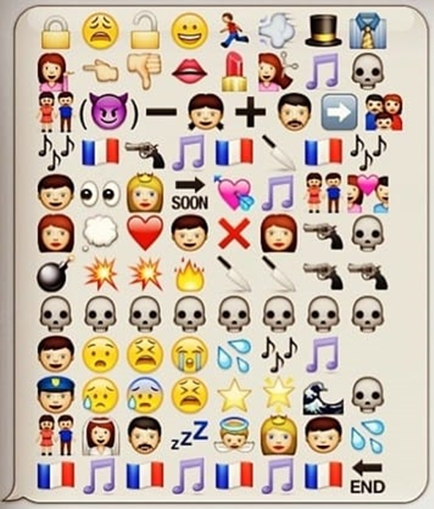
Conversation 4

Slide 26
Conversation 4
This is the story of the novel, later a film and a staged production, Les Misérables, told in Emoji format.
How useful is this as a means of communication?

Slide 27
Key messages
Images can aid communication, however, they can be interpreted in multiple ways, which means they become less specific and less precise than words.
Over-reliance on images may obfuscate meanings, thus impeding communication.
Some images have connotations that are culturally sensitive or taboo. Using an image that may represent a word or concept you would normally avoid in conversation, could cause offence.

Slide 28
TIME FOR ACTIVITY
ACTIVITY NUMBER: 1.3.3
ACTIVITY TITLE: Teaching and researching language and culture
ACTIVITY DURATION: 30
COMMENTS: Shared group reading of extracts from an academic text

Slide 29
Teaching and researching language and culture
Language is an important factor in developing intercultural communication because it is the predominant mode in which communication takes place.
In her book Teaching and Researching Language and Culture, Joan Kelly Hall discusses the connections between identity, culture and language.

Slide 30
Teaching and researching language and culture
You will now read three extracts from chapter 2 of that book.
How do the extracts help us when preparing to move into an intercultural context?

Slide 31
Discussion
If our identities, cultural beliefs and attitudes influence our ways of communicating, to what extent, can we, through our personal agency, mediate our behaviour, so that it is not alienating and so that our communications are successful?

Slide 32
Article 1: Relevance of social identity
Summary:
Although we may have very obvious differences in culture or identity with those we seek to communicate with at a particular moment, there are occasions when markers of identity or culture such as ‘nationality’ may be less important than other social or even professional identities we may have in common, such as those of ‘student’, ‘female car mechanic’, ‘colleague’ or ‘client’.

Slide 33
Article 2: Agency and identity
Summary:
We all have multiple identities and belong to different cultural groups. These cultural identities are constantly changing as we move between groups and can influence the way we use language, both to describe ourselves and to conceive of others. This may lead to unexpected outcomes.

Slide 34
Article 3: Research by Dr T. Kandiah
Summary:
Lack of shared (cultural) knowledge can lead to miscommunications. However, it is also possible for miscommunications to arise from the use of language (and thought) to interpret differences in communication cues as problematic, and to then use strategies to impede successful communication with an interlocutor deemed “disfluent” or less able to communicate or less worthy of effort to communicate with.

Slide 35
Key messages
‘Culture’ is multifaceted and individuals can belong simultaneously to many ‘cultural’ groups.
This means that it is possible to share aspects of the ‘culture’ with someone, even when you (or they) identify as belonging to different or distinct cultural groups.
Attitudes or beliefs which seek to emphasise cultural difference and separateness are more likely to result in communication which is “disfluent”, disjointed and unsuccessful, than those which seek to engage with, amplify and clarify what is being communicated.

Slide 36
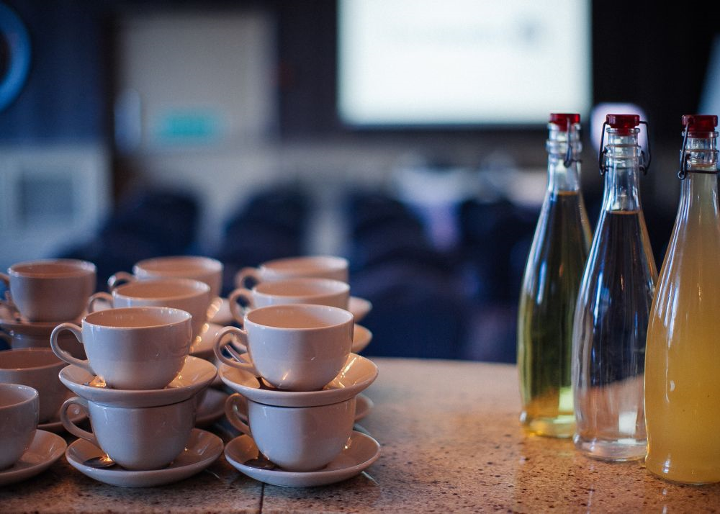
Break

Slide 37
TIME FOR ACTIVITY
ACTIVITY NUMBER: 1.3.4
ACTIVITY TITLE: Bloom’s Taxonomy – the affective domain
ACTIVITY DURATION: 40 minutes
COMMENTS:

Slide 38
Principles of intercultural communication
The first principle that must underpin intercultural communication is the wish for the communication to be successful.
For this reason, it is guided by principles that are intended to ensure the exchange of information across cultural boundaries is meaningful, unambiguous, preserves mutual respect and minimises antagonism.

Slide 39
What do we need for successful communication?
A recognition that there are different systems of communication and different understandings of what is socially acceptable.
A positive attitude to difference.
The willingness and ability to adapt to different contexts.
Skills as communicator in your first language.

Slide 40
Bloom’s Taxonomy: The affective domain
When most people discuss Bloom’s taxonomy, the model that is usually considered is the cognitive domain. There are, however, three domains:
the cognitive
the sensory
the affective.

Slide 41
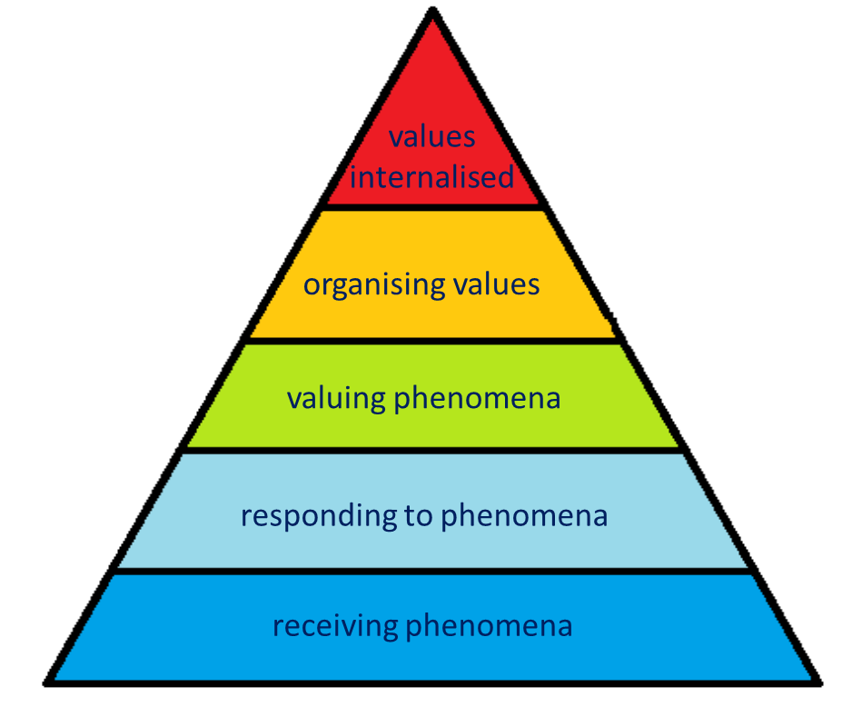
Bloom’s taxonomy: the affective domain

Slide 42
Bloom’s Taxonomy: The affective domain
The affective domain is very relevant to intercultural communication.
It provides a framework to describe behaviours.
Behaviours, and the feelings and sentiments that motivate them, connect closely with the core values, attitudes and motivations described in the ‘Iceberg of Culture’.

Slide 43
Reading activity - 1
You will be given six paragraphs from a text about Bloom’s affective taxonomy. Your tasks are:
Organise the paragraphs in order to make a coherent text
Summarise the content of each paragraph in no more than three words
Check your work against the original text

Slide 44
Reading activity - 2
Now you will be given five examples of communicative actions. Your task is:
Match the actions to the corresponding levels in the pyramid
Suggest three associated behaviours to go with each action
Compare your work with that of the other groups and make any changes/revisions

Slide 45
Bloom’s taxonomy: the affective domain

Slide 46
TIME FOR ACTIVITY
ACTIVITY NUMBER: 1.3.5
ACTIVITY TITLE: Verbal and non-verbal communication
ACTIVITY DURATION: 30
COMMENTS:

Slide 47
Verbal Communication
Much of today’s session has been concerned with verbal communication.
Verbal communication takes place through the medium of words.
The words may be spoken
e.g. conversation, discussion, lecture, interview, broadcast etc.
or written
e.g. email, letter, application form etc.

Slide 48
Verbal communication
Verbal communication can operate in a face-to-face situation or a remote situation.
Individuals involved in intercultural experiences need to develop a set of skills to support their communication, especially in face-to-face situations.
Bloom’s Taxonomy of the affective domain is a tool that can assist them.

Slide 49
Non-verbal communication
This can be conscious or unconscious.
Conscious non-verbal communication is where we choose to use physical actions, gestures, mime etc. to communicate a meaning
Unconscious non-verbal communication is where the actions we take, without intending to, signal messages to our interlocutors.

Slide 50
Non-verbal communication
We can communicate non-verbally just as loudly as we can with words.
VISUAL and NON-VERBAL
Eye contact
Silence
Personal space
Physical touch
Posture and movement
Gesture and facial expression
Dress and appearance

Slide 51
Why does non-verbal communication matter?
The way we listen to people, the way we make eye contact, are all examples of signals that can tell the person you are speaking to:
how interested you are
how truthful or sincere you are
In this way, non-verbal communication can generate mistrust and confusion as well as reassurance

Slide 52
Why does non-verbal communication matter?
When non-verbal signals match up with what an individual says, it makes for a more cohesive message and can increase rapport between interlocutors, so building trust and understanding.
When non-verbal signals DON’T match up with what an individual says, the potential for miscommunication increases, along with confusion, uncertainty and doubts about the sincerity of the communication

Slide 53
Types of non-verbal communication
Eye contact
vision is the predominant sense for the majority of us. The way we look at another person may indicate interest, hostility, affection, boredom, attraction.
Personal space
the amount of personal space individuals require varies according to culture. As well as signs of intimacy or affection, physical closeness may also communicate aggression or dominance.
Source: www.helpguide.org/articles/relationships-communication/nonverbal-communication.htm

Slide 54
Types of non-verbal communication
Posture and body movement
the way we stand, walk, sit, or hold our head may signal our true feelings
pay attention to posture, bearing and stance
Dress and appearance
we can signal a personal view of ourselves:
creativity, wealth, power, sense of fashion;
our attitudes to values such as modesty;
our affiliation to social movements or religious groups
Source: www.helpguide.org/articles/relationships-communication/nonverbal-communication.htm

Slide 55
Types of non-verbal communication
Gestures
the way we point, beckon or use our hands in other ways are important. Gestures tend to have DIFFERENT meanings across cultures and regions
Facial expressions
facial expressions for happiness, sadness, anger, surprise, fear and disgust tend to be the same across cultures
Source: www.helpguide.org/articles/relationships-communication/nonverbal-communication.htm

Slide 56
Types of non-verbal communication
Touch
the significance of a touch can vary greatly across cultures. What impressions might be made by a weak handshake, a slap on the back, a pat on the head, a hug, or a hand on someone’s arm?
Silence
used positively, it can allow others to communicate their messages, but used negatively it can oblige others to silence
Source: www.helpguide.org/articles/relationships-communication/nonverbal-communication.htm

Slide 57
Non-verbal communication in action
You are going to watch a short video clip that depicts several examples of nonverbal communication.
Use the viewing sheet to check off the examples as you see them.
Work in your groups to answer the questions on the viewing sheet

Slide 58
Non-verbal communication

Slide 59
TIME FOR ACTIVITY
ACTIVITY NUMBER: 1.2.6
ACTIVITY TITLE: Preparing for an intercultural experience
ACTIVITY DURATION: 10 minutes
COMMENTS:

Slide 60
Preparing for an intercultural experience
When preparing for an intercultural experience it is also helpful to:
Talk to colleagues who have been in that context before you. This will help to gain insight and relevant information.
Be aware of your own ‘culture’. Everyone has personal beliefs, attitudes and assumptions that might impact on how they communicate. Be ready to challenge these beliefs, and to have them challenged.

Slide 61
Preparing for an intercultural experience
Intercultural experiences are a fantastic opportunity for personal and professional development. Build your skills, but also:
be open and prepared for new experiences
be ready to adapt your behaviour where necessary
anticipate the best outcomes, not the worst!

Slide 62
Avoiding intercultural shock and/or conflict
Don’t panic – intercultural shock is a rare!
Moving to any new situation, for example, starting school, starting a new job, or moving house, can lead to a certain amount of disorientation, but this is not, in itself, a cause for panic or conflict.
An intercultural experience will be different, new, but hopefully not a shock.

Slide 63
Avoiding intercultural shock and/or conflict
Finding out about local customs and habits before you go is proactive and corresponds to the ‘Organising Phenomena’ level of Bloom’s taxonomy of the affective domain.
Avoiding cultural stereotypes (see Module 1 Unit 2) makes it less likely that you will miscommunicate or cause offence.
Showing your openness through non-verbal signals as well as what you say will assist communication.
We will cover intercultural shock in more detail in Module 2 Unit 3).

Slide 64
Further Reading
Hall, J. K., (2013) Teaching and Researching: Language and Identity, Pearson India
Bührig, K. and Thije, J. (2006) Beyond Misunderstanding: Linguistic Analyses of Intercultural Communication, Amsterdam: John Benjamins.
The twelve chapters in this volume examine intercultural communication in a variety of settings and from a variety of theoretical frameworks to demonstrate how individuals draw on a range of linguistic resources to construct mutual understandings in their interactions.

Slide 65
E – Learning resources
A useful website is https://www.helpguide.org/articles/relationships-communication/nonverbal-communication.htm

Slide 66
Reflection
Take a few minutes to note down your responses to what you have covered today:
Forms of intercultural communication
Methods of intercultural communication
Personal agency in communication
The affective domain of Bloom’s Taxonomy
Verbal and non-verbal communication
How does this content help you prepare for an intercultural experience?

Slide 67
Congratulations!
You have completed this unit

