Slide 1
Module 1 Developing intercultural competence through cultural awareness and effective intercultural communication
Unit 2
Developing Cultural Awareness

Slide 2
MODULE 1 UNIT 2
Module title | Developing intercultural competence through cultural awareness and effective intercultural communication
Unit title | Developing cultural awareness
Learning objectives | To support participants to develop their knowledge and understanding of conceptual and theoretical models related to interculturality. To enable participants to develop a critical understanding of their own cultural experience and heritage To consider how this understanding can assist them to model appropriate attitudes and behaviours when working with diverse learners taking part in intercultural VET programmes and experiences. To support participants to become familiar with the concepts of culture and intercultural competence.
Training hours | 3 hours (plus online activities for whole module)

Slide 3
UNIT CONTENT
Introducing concepts of identity, culture and intercultural competence
Exploring how one’s own cultural background has shaped one’s own identity and world view, and informed cultural biases
The ‘iceberg model’ of culture
Traditional ‘essentialist’ and non-essentialist models of culture
Different aspects of cultural competence for VET learners and participants, and challenges faced in VET mobility contexts

Slide 4
TIME FOR ACTIVITY
ACTIVITY NUMBER: 1.2.1
ACTIVITY TITLE: Recognising that personal identity, beliefs, attitudes and culture impact on our behaviour.
ACTIVITY DURATION: 5 minutes

Slide 5
Developing Cultural Awareness
Before an individual begins to explore cultural competence, it is important to consider:
the individual’s personal sense of identity
the individual’s individual cultural background
These aspects of our personalities are ever present, even when we are not conscious of them. We should be aware of, understand, and be responsive to the way they might be evidenced in any biases that individuals might bring to any intercultural context.

Slide 6
TIME FOR ACTIVITY
ACTIVITY NUMBER: 1.2.2
ACTIVITY TITLE: An introduction to the idea of ‘identity’
ACTIVITY DURATION: 40 minutes
COMMENTS: To determine elements that describe our legal, national and personal identity

Slide 7
What shapes my identity?
The trainer will give you a set of cards and a matrix
Work in groups to sort the cards into the most suitable spaces on the matrix
Any cards that you cannot agree on as a group should be left to one side
When you have completed the task, take a photograph of your result to post in the online discussion room

Slide 8
Discussion
Did you find it difficult/impossible to place any of the cards?
which ones?
why?
Look again at the items you placed under ‘legal’.
what rights can you claim as a result of having these items?
what duties are you responsible for as a result of having these items?

Slide 9
Discussion
Now look at the items you place under ‘national’ and ‘personal’.
Do any of these items make similar demands or convey similar rights as those under ‘legal’?
How easy is it for people to describe the identity of a person by looking at the items you placed under ‘legal’?
What about the items under ‘national’ and ‘personal’?

Slide 10
Key messages
The things we own or possess can be seen as markers of our identity, particularly those that we choose for ourselves.
In a similar way, the things we do and the roles we fulfil can also help describe our identity.
We each fulfil many roles in life, so our identity is multifaceted; we could claim to have not just one, but multiple identities.

Slide 11
Multiple identities
Aunt to her sister’s daughter
Daughter to her widowed mother
Warden at her parish church
Badminton partner to her friend Sonya
Mother to her three teenage children
Wife of 17 years to her husband Peter
Headteacher at a London high school
Sister-in-law to Richard

Slide 12
My multiple identity
Work in pairs
The trainer will label one of you ‘A’ and the other ‘B’
Tell each other about the different aspects of your identity
A will report back on those areas that you have in common
B will report back on those areas that are different

Slide 13
Key Question 1
Why is it important to consider aspects of our identity that we have in common as well as those that are different?

Slide 14
TIME FOR ACTIVITY
ACTIVITY NUMBER: 1.2.3
ACTIVITY TITLE: The Iceberg Model of Culture
ACTIVITY DURATION: 25 minutes
COMMENTS: To introduce participants to a theoretical model of culture

Slide 15
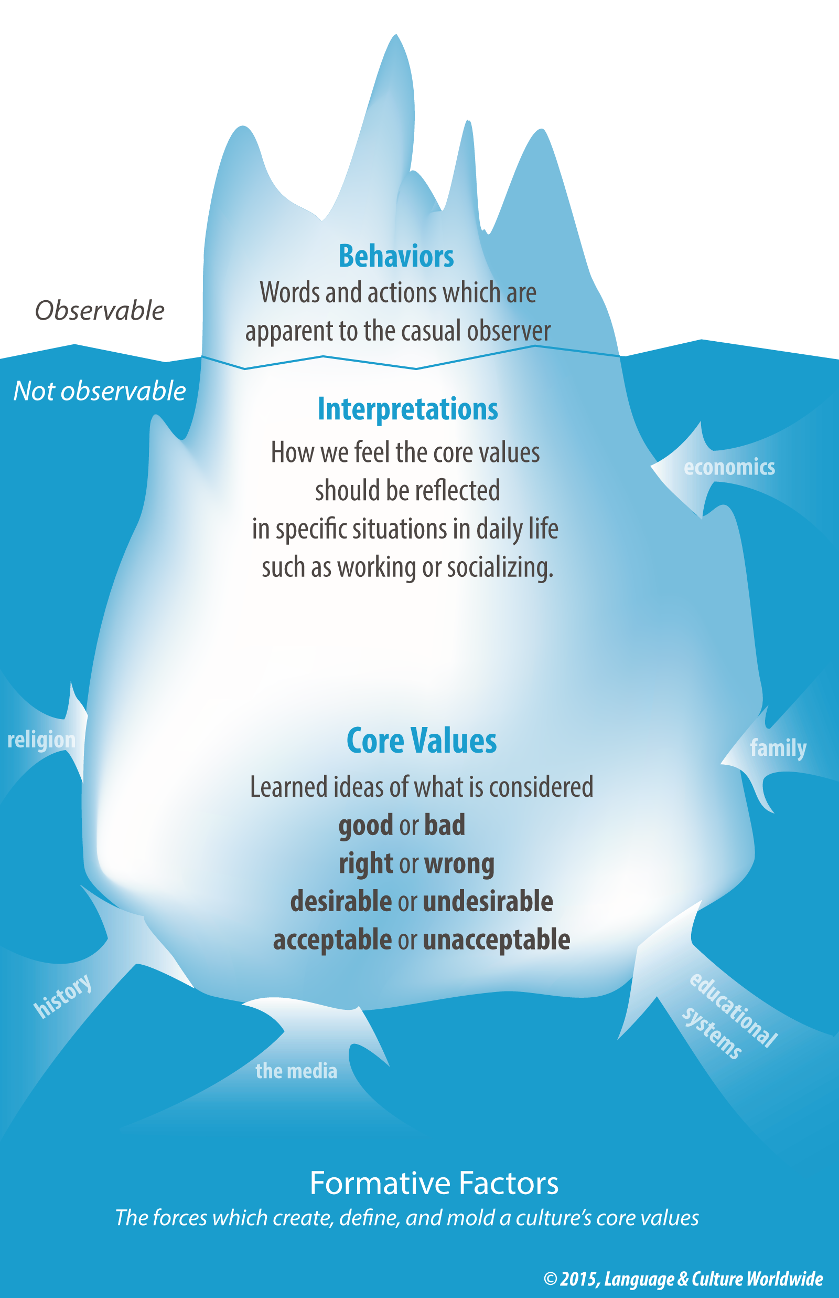
The Iceberg model of Culture
Work in group to write a joint explanation of the image on the left for someone who cannot see it.
Image reproduced with kind permission of Language & Culture Worldwide: https://www.languageandculture.com/home

Slide 16
The Iceberg model of Culture
‘Culture’ has sometimes been described as an iceberg.
Only a small part of an iceberg’s mass is visible above water. The greater part of it is below the surface and therefore unseen.
The model exemplifies how the surface features of culture (behaviours) are visible, whereas the things that underpin culture (core values) lie deep below the surface.

Slide 17
Reconstructing a text
You will be given five paragraphs. Each one is part of an explanation of the iceberg model of culture.
Work in your groups to arrange the paragraphs to create a magazine article about the Iceberg model of Culture.

Slide 18
Key Question 2
How does the iceberg model help us to understand the idea of ‘culture’?

Slide 19
Key messages
The iceberg is a useful for understanding the concept of ‘culture’. It helps us to visualise how most of our deeply the beliefs, values, moral attitudes and understandings etc. – in other words, what we call ‘culture’ – are embedded within us. ‘Culture’ might be guessed at through our visible behaviours or appearances, but is actually much deeper and complex than what we present as ‘face value’.

Slide 20
TIME FOR ACTIVITY
ACTIVITY NUMBER: 1.2.4
ACTIVITY TITLE: Identity and Culture
ACTIVITY DURATION: 30 minutes
COMMENTS: To explore the links between identity and culture and their relationship with concepts such as nationality and ethnicity

Slide 21
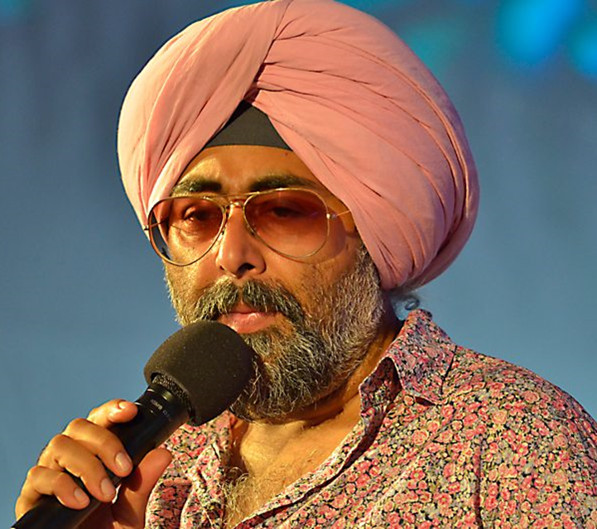
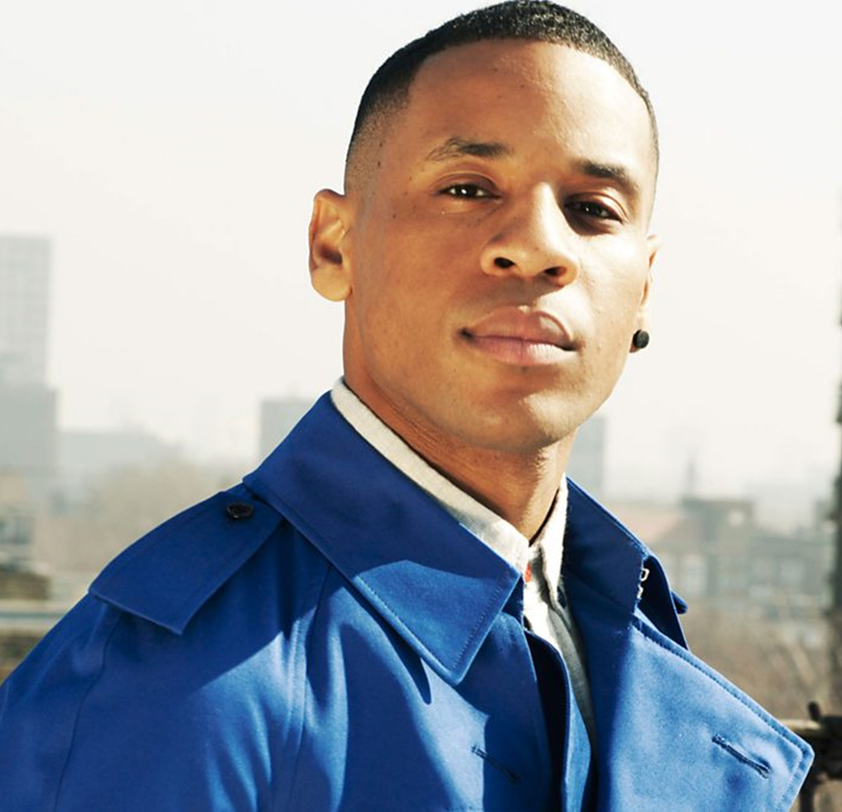
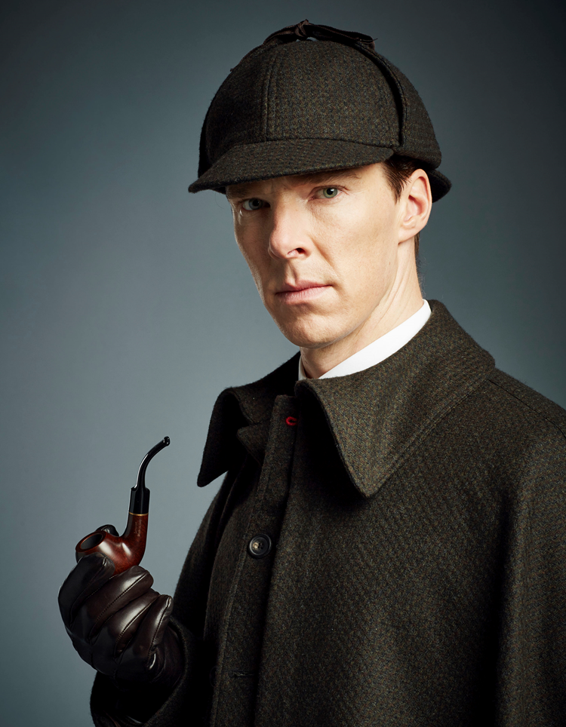
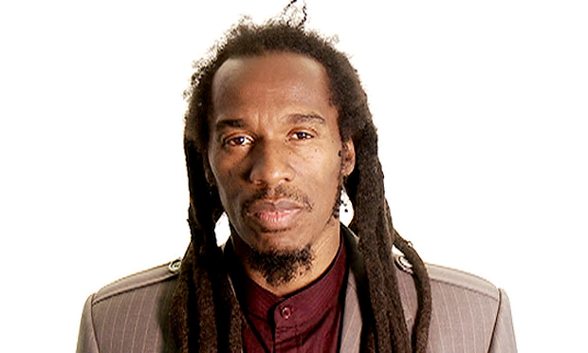
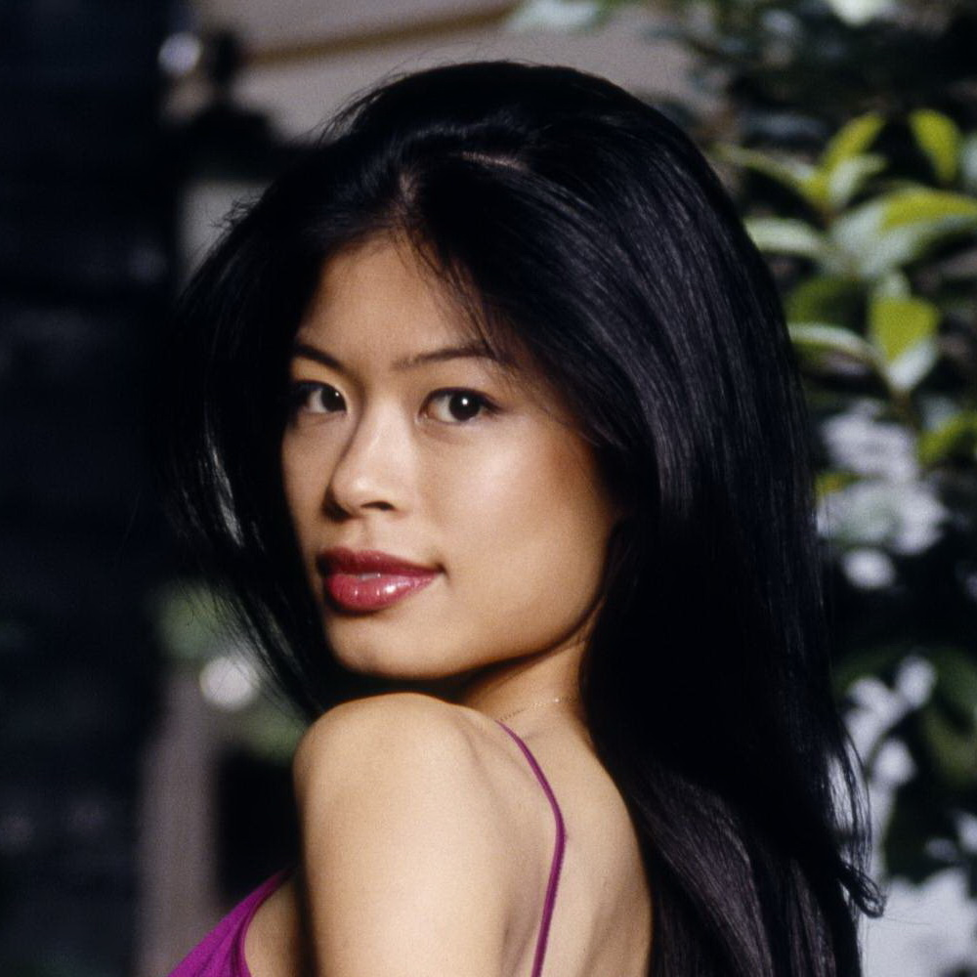
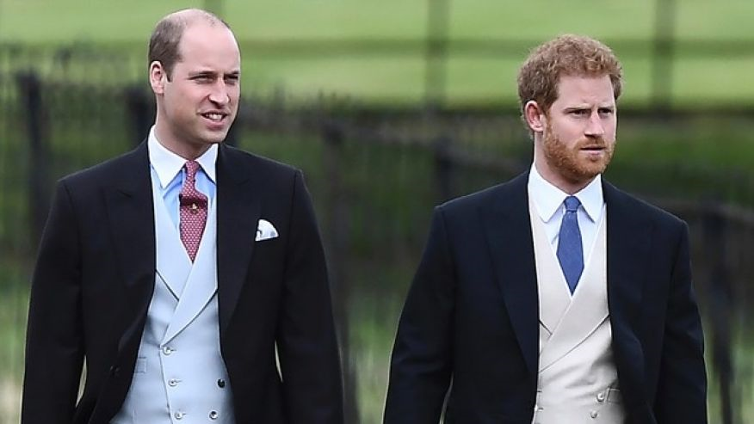
Personal identities and culture
These people are all well known in the country where they live. Can you guess which cultures they belong to?

Slide 22
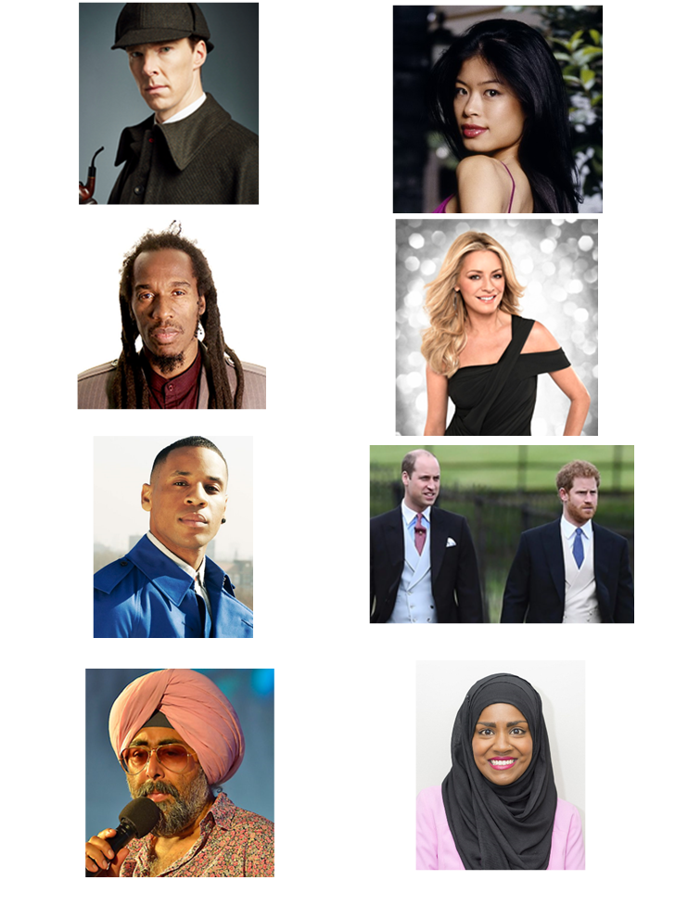
Personal identities and culture

Slide 23
Personal identities and culture
How many different answers did you get?
How easy was it to decide on an answer?
What assumptions did you make to help you arrive at your answers?
Do you think culture is always visible?
Why?
Why not?

Slide 24
What assumptions do we make about ‘culture’?
Does ‘culture’ imply ‘nationality’ or ‘ethnic heritage’?
If these people are all British, what cultural behaviours might they all share?
They all eat roast beef
They all speak English
They all drink tea with milk and sugar
They all appear regularly on British television
They all live in a house with a garden
They all talk about the weather

Slide 25
Cultural behaviours
Facts
They all speak English
They all appear regularly on British television
Stereotypes
They all eat roast beef
They all drink tea with milk and sugar
They all live in a house with a garden
They all talk about the weather

Slide 26
Multiple identities, behaviours and culture
The trainer will now give you a representation of a multiple identity.
Compare it with the cultural behaviours that this person engages in as a result of her identity.
To what extent are her behaviours bound by her nationality (she is British) or her ethnicity and to what extent do they transcend both of these concepts?

Slide 27
Key messages
‘Culture’ is not tangible; it is a social construct.
Individuals can share the same deep core values that impact on, and define their ‘culture’ despite coming from diverse backgrounds.
In developing intercultural competence, stereotyping should be avoided!

Slide 28
Key Question 3
How do you think your cultural background has influenced your ideas about culture in general?

Slide 29
TIME FOR ACTIVITY
ACTIVITY NUMBER: 1.2.5
ACTIVITY TITLE: Essentialist and non-essentialist models of culture
ACTIVITY DURATION: 25 minutes
COMMENTS: To familiarize participants with specific theoretical frameworks

Slide 30
Models of culture
Essentialist | Non-essentialist or Anti-essentialist
Rooted in human nature | Rooted in human conditions
Static | Dynamic/changing
Homogenous | Heterogeneous
Holistic | Fragmented
Deterministic | Changeable
Bounded | Blurred boundaries
Adapted from Dr Ganesh Nathan: Institute of Management,
University of Applied Sciences and Arts Northwestern Switzerland (FNHW); Professor at the Business School of Lausanne.

Slide 31
The essentialist view of culture
Assumes a singular cultural identity
Suggests clear cultural boundaries
Implicitly or explicitly supports ideas of ‘national culture’, cultural conformity etc
Ignores multiple identities that can shift over time and space
Can lead to stereotyping

Slide 32
The non-essentialist view of culture
Assumes multiple cultural identities
Recognises that multiple identities that can shift over time and space
Describes blurred boundaries and continuity between cultures
Rejects the limitations of cultural conformity
Makes room for agency, choice and change

Slide 33
Applying essentialist and non-essentialist models
What model of culture would you say the following statements belong to?
The British eat roast beef on Sundays.
Spanish attitudes to bullfighting has changed in the last 20 years.
Nigerian men are invariably fraudsters.
Italians are exuberant, passionate and ‘talk with their hands’.
People over 50 years of age love Facebook.

Slide 34
Key messages
Our deep core values help to shape our identities.
Our values and identities influence our behaviours.
Our behaviours point to our ‘culture’.
Non-essentialist views of culture can transcend concepts such as nationality.

Slide 35
TIME FOR ACTIVITY
ACTIVITY NUMBER: 1.2.6
ACTIVITY TITLE: Case studies in Cultural Competence
ACTIVITY DURATION: 30 minutes
COMMENTS: To begin to explore some challenges faced in VET mobility contexts

Slide 36
Case studies
You will be given a case study to work on in pairs.
After reading it, try and work out:
the main areas of misunderstanding in each scenario
what the protagonists could have done to resolve the situation
The trainer will then ask you to share your work with another pair.

Slide 37
Case studies
You will now share your case study with another group of four who have considered a different case study.
Be ready to feed back the main points of your discussion to the trainer.

Slide 38
Further Reading
Nathan, Ganesh. A non-essentialist model of culture. International Journal of Cross Cultural Management. April 2015. Available at: https://www.researchgate.net/publication/276832447_A_non-essentialist_model_of_culture
Holiday, Adrian. Intercultural Communication and Ideology. Sage Publications (2010)

Slide 39
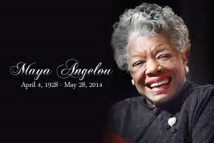
Endnote…
Enjoy this video of Maya Angelou reading one of her poems: “Human Family”
The images are provided by Amy Rebitski

Slide 40
TIME FOR ACTIVITY
ACTIVITY NUMBER: 1.2.7
ACTIVITY TITLE: Personal reflection
ACTIVITY DURATION: 10 minutes
COMMENTS: To begin to explore some challenges faced in VET mobility contexts

Slide 41
Reflecting on Key Questions
Use the last 10 minutes of the session to begin formulating answers to our key questions
Why is it important to consider aspects of our identity that we have in common as well as those that are different?
How does the iceberg model help us to understand the idea of ‘culture’?
How do you think your own cultural background has influenced your ideas about culture in general?

Slide 42
Congratulations!
You have completed this unit

