Slide 1
Module 1 Developing intercultural competence through cultural awareness and effective intercultural communication
Unit 1
Understanding interculturality
in the context of VET

Slide 2
Introduction and overview of Module 1
Welcome to Module 1 of this training programme for VET providers and organisations.
This first module aims to develop and enhance the intercultural competencies of VET practitioners engaged in intercultural mobility programmes and experiences.
By reflecting on and developing their own intercultural competencies, organisations and practitioners will be able to work more effectively with learners and participants in intercultural VET contexts.

Slide 3
Overview of Module 1
Unit | Session focus
Unit 1.1 | Understanding interculturality in the context of VET
Unit 1.2 | Developing cultural awareness
Unit 1.3 | Developing intercultural communication skills

Slide 4
Assessment
Assessment of this module is largely informal and through:
Self-assessment
Trainer observations of contributions to discussion
Contributions to the online discussion

Slide 5
MODULE 1 UNIT 1
Module title | Developing intercultural competence through cultural awareness and effective intercultural communication
Unit title | Understanding interculturality in the context of the VET professional
Learning objectives | To explore the role and value for the individual, of personal and professional development through intercultural VET programmes and experiences. To reflect on professional intercultural VET roles and review existing skills, knowledge and competencies, both personal and organisational.
Training hours | 3 hours (plus on line activities for whole module)

Slide 6
UNIT CONTENT
Exploring key concepts in intercultural VET experiences
Introduction to the key standards (linked to key competencies) for intercultural VET providers and practitioners
Considering professional development in the context of intercultural communication

Slide 7
TIME FOR ACTIVITY
ACTIVITY NUMBER: 1.1.1
ACTIVITY TITLE: Introductions
ACTIVITY DURATION: 15 minutes
COMMENTS:

Slide 8
Introductions
Talk to the person next to you
You will need to find out
his/her name
her/her job or intended job
something special that s/he does away from work and training
When the trainer asks you, introduce the person next to you to the whole group

Slide 9
Key message
In intercultural communication it is vitally important that you listen to what is being communicated.
We are often preoccupied with what we want to say . It is a skill to be able to listen to others, process what they communicate and relay it to others.

Slide 10
TIME FOR ACTIVITY
ACTIVITY NUMBER: 1.1.2
ACTIVITY TITLE: Talk stations
ACTIVITY DURATION: 20 minutes
COMMENTS:

Slide 11
Talk stations
Stand at one of the talk stations around the room and the trainer will allocate you a letter, A or B.
When the trainer asks you, discuss the word on the talk station card. You may write on the card if you want to.
The trainer will ask person A to move anti-clockwise one station and person B clockwise one station.
When the trainer asks you, discuss the word on the card at your new talk station. Again, you may write on the card if you want to.

Slide 12
TIME FOR ACTIVITY
ACTIVITY NUMBER: 1.1.3
ACTIVITY TITLE: Key definitions
ACTIVITY DURATION: 15 minutes
COMMENTS:

Slide 13
Key definitions
You will be given eight definitions but not told what is being defined.
Work in pairs to write what you think is being defined in the question mark (?) box.
The trainer will discuss your answers with you at the end.

Slide 14
TIME FOR ACTIVITY
ACTIVITY NUMBER: 1.1.4
ACTIVITY TITLE: Key standards
ACTIVITY DURATION: 20 minutes
COMMENTS:

Slide 15
Key standards
What are the key standards for intercultural VET providers and practitioners?
Our project research suggests that formal standards and qualifications for effective intercultural provision vary considerably from country to country
Read the extract from The Cultural Competence Framework to gain an insight into the thinking behind this training programme.

Slide 16
Coffee break
This Photo by Unknown Author is licensed under CC BY-SA

Slide 17
Key standards
Our project research suggests that formal standards and qualifications in effective intercultural practice vary considerably from country to country.
In the UK and Italy there are professional qualifications, including at master’s level.

Slide 18
Key standards
In the UK, National Occupational Standards are overseen by an organisation called Skills CFA.
Skills CFA is not a government body. It is a third-sector organisation.
Skills CFA have published occupational standards which include a specific section called “Intercultural Working”.

Slide 19
Skills CFA key standard 1
Here is an example of one performance criterion for Intercultural Working:
Develop your skills to work effectively with people from different countries or diverse cultures
The trainer will give you two performance criteria to look at.
Work in a pair to complete the performance criteria sheet and report back to the rest of the group.

Slide 20
The Skills CFA key standards
Develop your skills to work effectively with people from different countries or diverse cultures
Build working relationships with people from different countries or diverse cultures
Appoint people from different countries or diverse cultures
Manage a multicultural team
Manage delivery of a service to people from different countries or diverse cultures
Develop new markets with different countries or diverse cultures
Work with people from different countries or diverse cultures

Slide 21
TIME FOR ACTIVITY
ACTIVITY NUMBER: 1.1.5
ACTIVITY TITLE: The online platform
ACTIVITY DURATION: 15 minutes
COMMENTS:

Slide 22
Using the online platform
The online platform has a number of activities and additional information relevant to this training programme.
Everybody must login to gain access to the materials and post their responses to the online tasks.
You may also need to post the results of activities you complete in the face-to-face session on this platform.

Slide 23
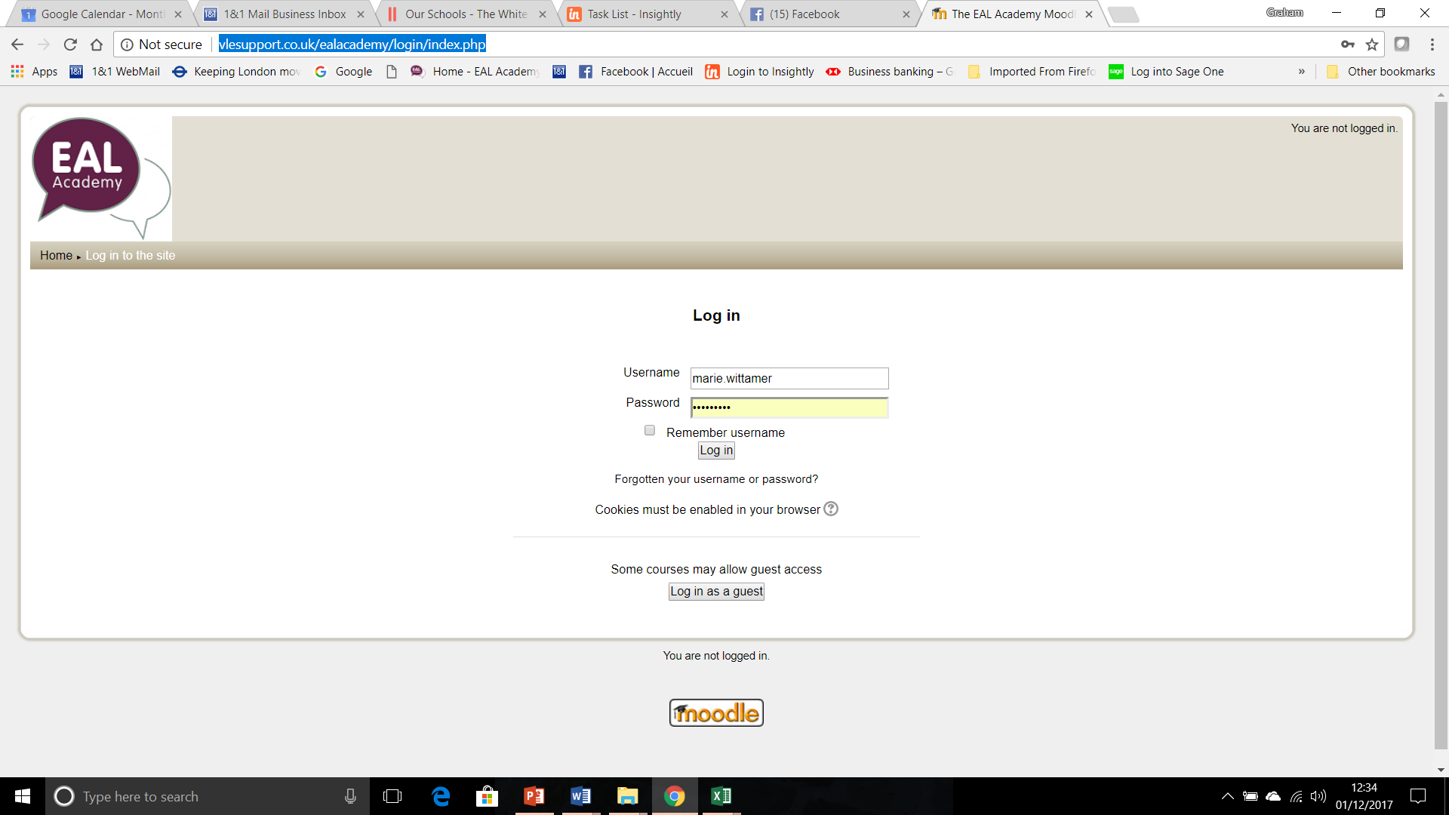
On line activities for Module 1
Go to
http://vlesupport.co.uk/ealacademy/login/index.php
and login with your ‘Username’ and ‘Password’

Slide 24
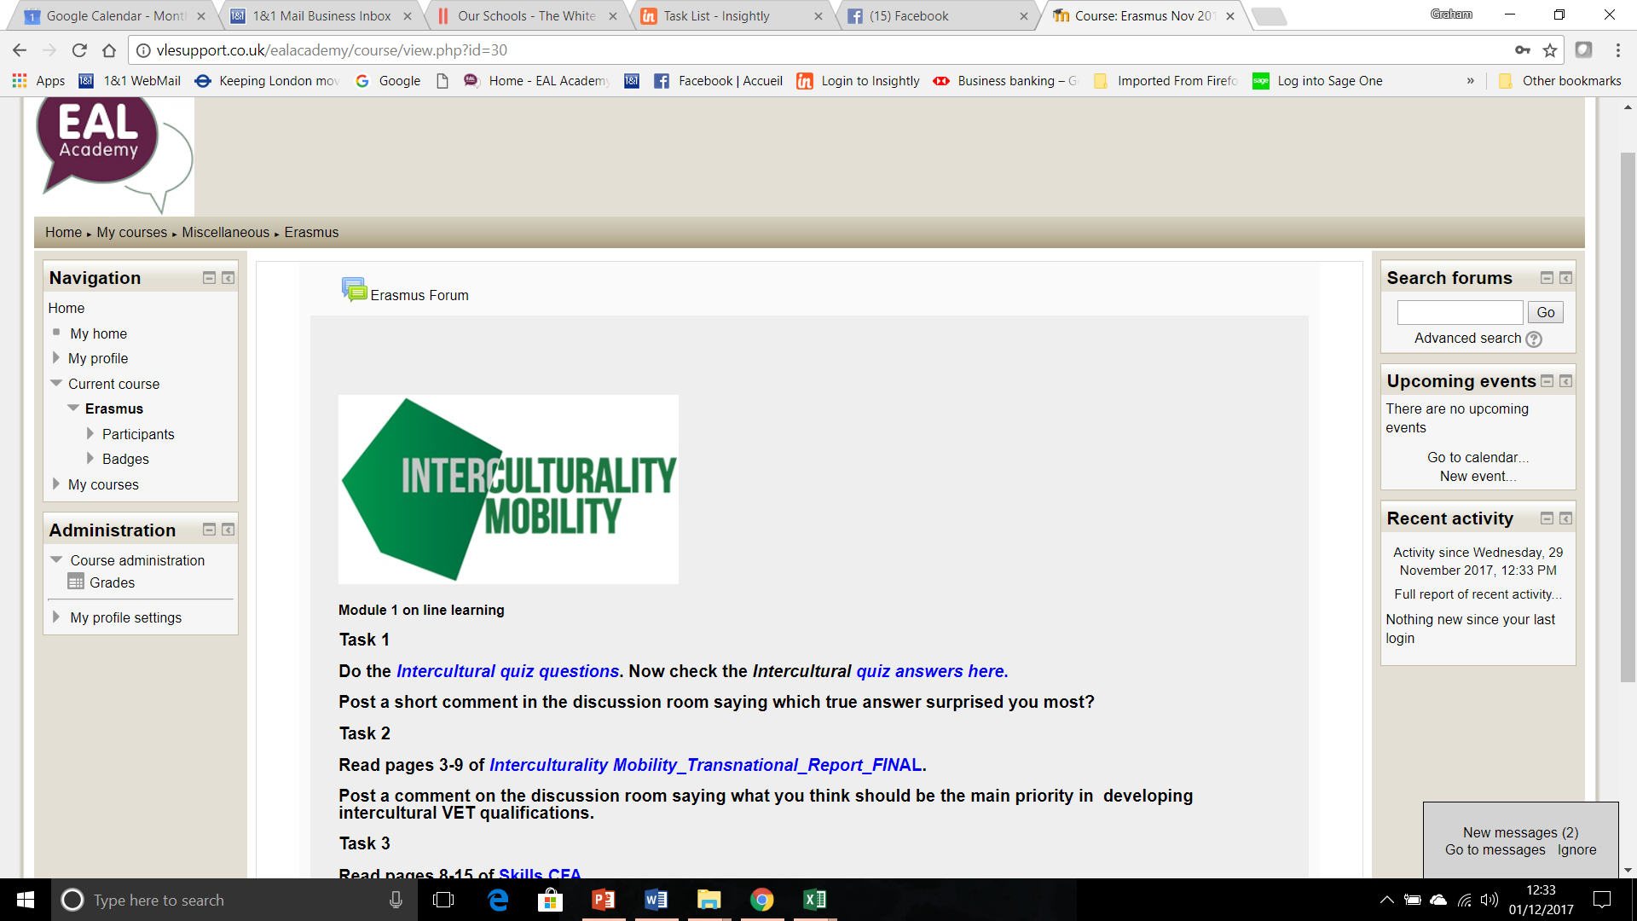
You should arrive at this page.
‘Click’ on the Erasmus forum

Slide 25
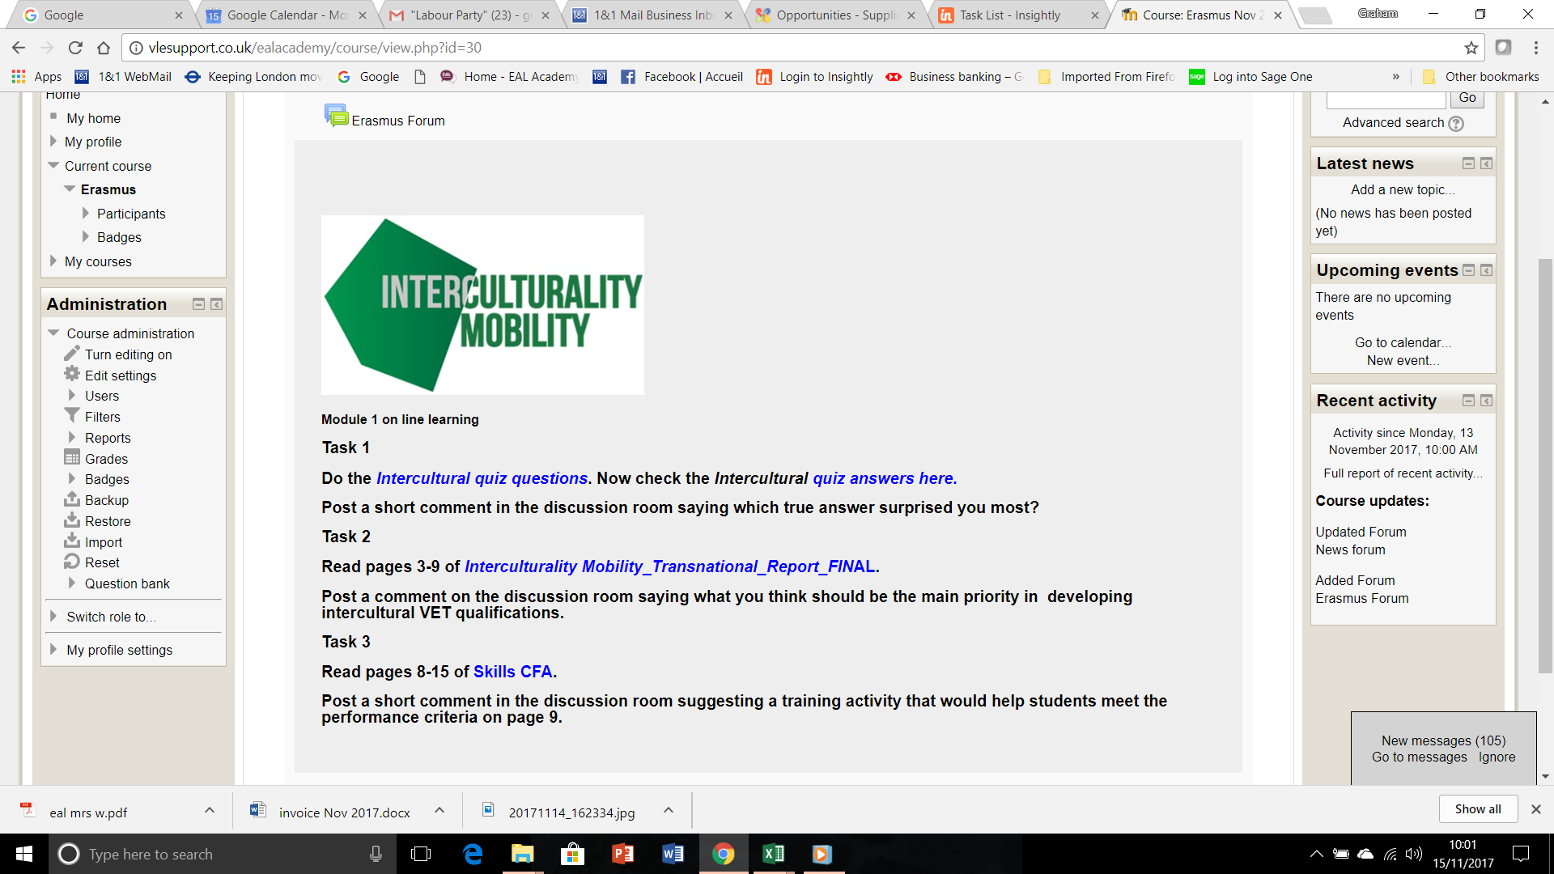
These are the tasks for Module 1

Slide 26
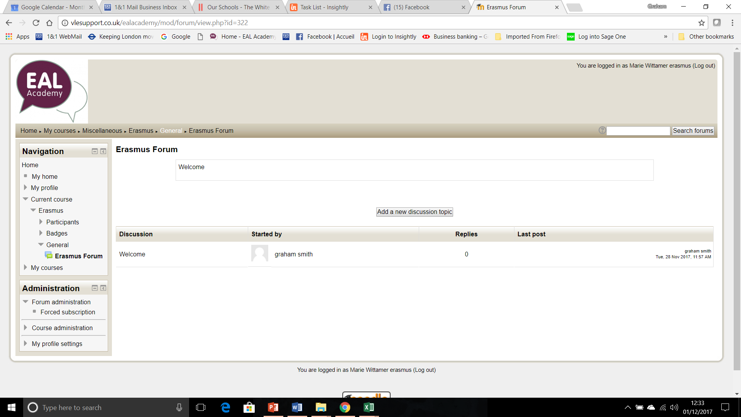
You can join an existing discussion or start a new discussion

Slide 27
Further Reading
Building Cross-Cultural Competence (2008), Hampden-Turner & Trompenaars
Exploring and Assessing Intercultural Competence (2006), Fantini & Tirmizi
Intercultural Working (2008), Skills CFA

Slide 28
Self-evaluation and reflection
What aspects of intercultural communication do you think are most relevant to your professional context?
How can your organisation support you to develop you knowledge, skills and competences in relation to intercultural communication?
You may wish to post your responses to these questions on the online platform, but this is not obligatory.

Slide 29
Congratulations!
You have completed this unit

